Slide 1

On the Identification of Variances and Adaptive Kalman Filtering

Slide 2

Kalman Filter Calculation:
A Kalman filter needs the exact knowledge of:
The process noise’s covariance matrix represented by Q
The measurement’s noise covariance matrix , represented by R

Slide 3
Paper Assumptions:
The true value of these 2 matrix is unknown.
Inputs are random and stationary.
The results are first derived for discrete systems, and then extended to continuous ones.

Slide 4
System Assumptions:
The system under consideration is time invariant.
It is completely controllable and observable.
Both the system and filter (whether they are optimal or suboptimal) area assumed to have reached steady-state conditions.

Slide 5
Path to Solution:
A correlation test is given in order to check whether a particular Kalman filter is working optimally or not
In the case of suboptimal result a technique is given.
Using this technique an approximated normal, unbiased, and consistent estimates of Q and R are found
This technique only works for special cases where Q’s form is known and the number of its unknown elements is less than n*r. (n representing dimension of the state vector and r representing that of measurement vector.)
For other cases, the optimal steady-state gain represented by K_{op} is calculated iterative by an iterative procedure without identifying Q.

Slide 6

Formulas for Defining System:
A MULTIVARIABLE LINEAR DISCRETE SYSTEM
$$x_{i+1}= Φx_{i}+ Γu_{i}$$
$$z_{i}=Hx_{i}+ v_{i}$$
x_{i} is n*1 state vector
Φ is n*n nonsingular transition matrix
Γ is n*q constant input matrix.
z_{i} is r*1 measurement vector.
H is r*n constant output matrix.

Slide 7

Formulas for Defining System:
A MULTIVARIABLE LINEAR DISCRETE SYSTEM
Sequences u_{i} with n*1 and v_{i} with r*1 as their size, are uncorrelated Gaussian white noise sequences.
$$E\left\{u_{i}\right\}=o;E\left\{u_{i}{u_{j}}^{T}\right\}=Qδ_{ij}$$
$$E\left\{v_{i}\right\}=o;E\left\{v_{i}{v_{j}}^{T}\right\}=Rδ_{ij}$$
$$E\left\{u_{i}{v_{i}}^{T}\right\}=o. for all i.j$$
Initial state x_{o} is normally distributed with:
$$E\left\{x_{o}\right\}=o;Var\left\{x_{o}\right\}= E\left\{{x_{o}}_{i}{{x_{o}}_{j}}^{T}\right\}=P_{o}δ_{ij}$$

Slide 8

Formulas for Defining Filter:
$$K_{o}= M_{o}H^{T}{\left(HM_{o}H^{T}+R_{o}\right)}^{−1}$$
$$M_{O}= Φ\left[M_{O}−M_{O}H^{T}{\left(HM_{O}H^{T}+R_{O}\right)}^{−1}HM_{O}\right]Φ^{T}+ΓQ_{O}Γ^{T}$$
K_{o} is a n*r matrix representing the steady-state Kalman filter gain.
M_{o} is the steady-state solution to the covariance equation of Kalman.
Q_{o} and R_{o} are the initial states of Q and R

Slide 9

Formulas for Defining Filter :
FILTERING EQUATIONS
$${\hat{x}}_{i+1/i}= Φ{\hat{x}}_{i/i}$$
$${\hat{x}}_{i/i}= {\hat{x}}_{i/i−1}+K_{O}(z_{i}−H{\hat{x}}_{i/i−1})$$
${\hat{x}}_{i+1/i}$ is the estimate of x_{i+1} based on all the measurements up to i.

Slide 10

Two Cases:
Case 1: Optimal Kalman Filter:
Case 2: Suboptimal Kalman Filter:
When Q = Q₀ and R = R₀. In these cases M₀ is the covariance of the error in estimating the state.
The covariance of the error called M₁ , is given by the following equation:
$$M_{1}= E\left\{(x_{i}−{\hat{x}}_{i/i−1}){(x_{i}−{\hat{x}}_{i/i−1})}^{T}\right\}$$
$= Φ\left[M_{1}− K_{O}HM_{1}− M_{1}H^{T}{K_{O}}^{T}+ K_{O}\left(HM_{1}H^{T}+R\right){K_{O}}^{T}\right]Φ^{T}+ ΓQΓ^{T}$

Slide 11
Problem and Approaches:
THE TRUE VALUES OF Q AND R ARE UNKNOWN
Check whether the Kalman filter constructed using some estimations of Q and R are close to optimal or not. → Hypothesis Testing
Obtain unbiased and consistent estimates of Q and R. → Statistical Estimation
Adapt the Kalman filter at regular intervals using all the previous information → Adaptive Filtering

Slide 12

Simulation Given Parameters:
$Φ=\left[\begin{matrix}0.75 & −1.74 & \begin{matrix}−0.3 & \begin{matrix}0 & −0.15\end{matrix}\end{matrix} \\ 0.09 & 0.91 & \begin{matrix}−0.0015 & \begin{matrix} 0 & −0.008\end{matrix}\end{matrix} \\ \begin{matrix}0 \\ 0 \\ 0\end{matrix} & \begin{matrix}0 \\ 0 \\ 0\end{matrix} & \begin{matrix}\begin{matrix}0.95 \\ 0 \\ 0 \end{matrix} & \begin{matrix}\begin{matrix}0 \\ 0.55 \\ 0\end{matrix} & \begin{matrix}0 \\ 0 \\ 0.905\end{matrix}\end{matrix}\end{matrix}\end{matrix}\right]$ → Nonsingular Transition Matrix
$Γ=\left[\begin{matrix}0 & 0 & 0 \\ 0 & 0 & 0 \\ \begin{matrix}24.64 \\ 0 \\ 0\end{matrix} & \begin{matrix}0 \\ 0.835 \\ 0\end{matrix} & \begin{matrix}0 \\ 0 \\ 1.83\end{matrix}\end{matrix}\right]$ → Constant Input Matrix
$H=\left[\begin{matrix}1 & 0 & \begin{matrix}0 & 0 & 1\end{matrix} \\ 0 & 1 & \begin{matrix}0 & 1 & 0\end{matrix}\end{matrix}\right]$ → Constant Output Matrix
$Q=\left[\begin{matrix}q_{1} & 0 & 0 \\ 0 & q_{2} & 0 \\ 0 & 0 & q_{3}\end{matrix}\right]$→ Input Covariance Matrix
$R=\left[\begin{matrix}r_{1} & 0 \\ 0 & r_{2}\end{matrix}\right]$ → Noise Covariance Matrix

Slide 13

Initial Values:
$M_{O}=100 I=100 \left[\begin{matrix}1 & 0 & \begin{matrix}0 & 0 & 0\end{matrix} \\ 0 & 1 & \begin{matrix}0 & 0 & 0\end{matrix} \\ \begin{matrix}0 \\ 0 \\ 0\end{matrix} & \begin{matrix}0 \\ 0 \\ 0\end{matrix} & \begin{matrix}\begin{matrix}1 \\ 0 \\ 0\end{matrix} & \begin{matrix}0 \\ 1 \\ 0\end{matrix} & \begin{matrix}0 \\ 0 \\ 1\end{matrix}\end{matrix}\end{matrix}\right]$
$Q_{o}=\left[\begin{matrix}0.25 & 0 & 0 \\ 0 & 0.5 & 0 \\ 0 & 0 & 0.75\end{matrix}\right]$
$R_{o}=\left[\begin{matrix}0.4 & 0 \\ 0 & 0.6\end{matrix}\right]$

Slide 14

Optimality Test:
If the above values are given as initial values, then we are dealing with a suboptimal filter and as a result, we expect to see more than 5 percent of ${[{\hat{ρ}}_{k}]}_{ii}$outside of 95% confidence interval.
In order to find${[{\hat{ρ}}_{k}]}_{ii}$, sequence of $υ_{i}$ is simulated, and then the estimator of C_{k} meaning ${\hat{C}}_{k}$ is calculated with $k∈\{0.1. … .40\}$. After that, ${[{\hat{ρ}}_{k}]}_{ii}$ is computed with $i∈\{1. 2\}$
$${\hat{C}}_{k}= \frac{1}{N}\sum_{i=k}^{N}{ν_{i}{ν_{i−k}}^{T}}$$
$${[{\hat{ρ}}_{k}]}_{ij}= \frac{{ \left[ {\hat{C}}_{k} \right]}_{ij}}{\sqrt{{ \left[{\hat{C}}_{o} \right]}_{ii}{ \left[{\hat{C}}_{o} \right]}_{jj}}}$$

Slide 15
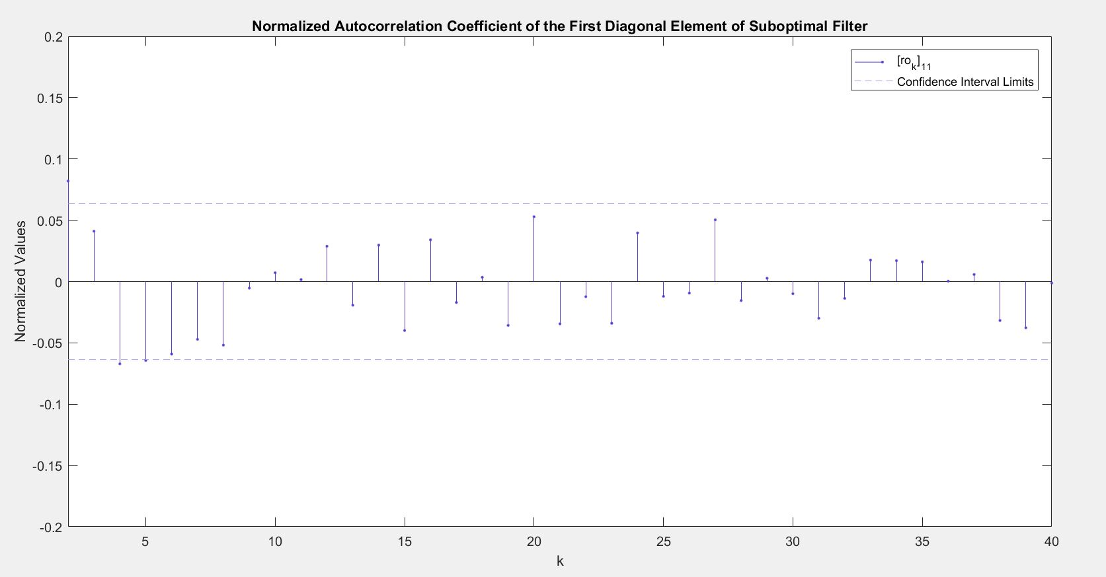
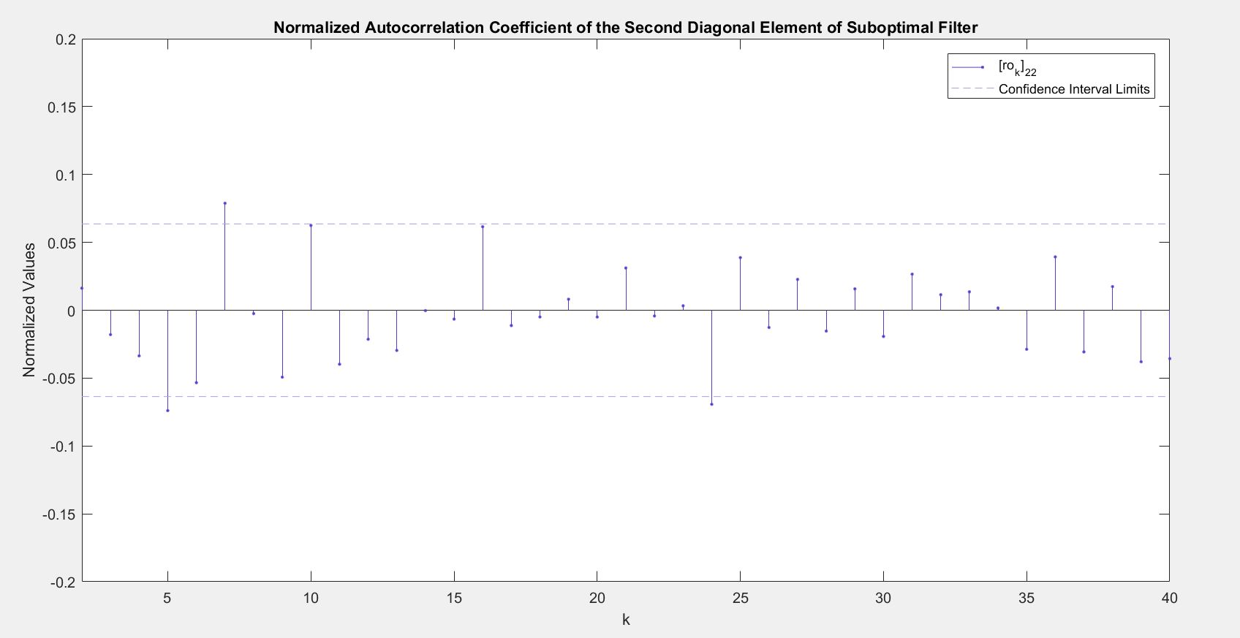
Optimality Test Results:

Slide 16

Formula for Calculating Estimators of Q and R:
${\hat{C}}_{k}= \frac{1}{N}\sum_{i=k}^{N}{ν_{i}{ν_{i−k}}^{T}}$
$$\hat{MH^{T}}=K{\hat{C}}_{O}+ A^{\#}\left[ \begin{matrix}{\hat{C}}_{1} \\ ⋮ \\ {\hat{C}}_{n}\end{matrix}\right] . A=\left[ \begin{matrix}HΦ \\ HΦ\left(I−KH\right)Φ \\ \begin{matrix}⋮ \\ H{\left[Φ\left(I−KH\right)\right]}^{n−1}Φ\end{matrix}\end{matrix} \right]$$
$$\hat{R}= \hat{C_{o}}−H\left(\hat{MH^{T}}\right)$$
$$\sum_{j=o}^{k−1}{{HΦ}^{j}Γ\hat{Q}Γ^{T}{\left(Φ^{j−k}\right)}^{T}H^{T}}=\hat{HM}{\left(Φ^{−k}\right)}^{T}H^{T}− {HΦ}^{k}\hat{MH^{T}} − \sum_{j=o}^{k−1}{{HΦ}^{j}\hat{Ω}{\left(Φ^{j−k}\right)}^{T}H^{T}} . for k=1. … . n$$

Slide 17
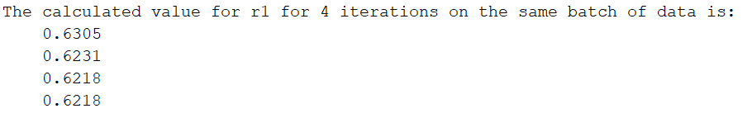
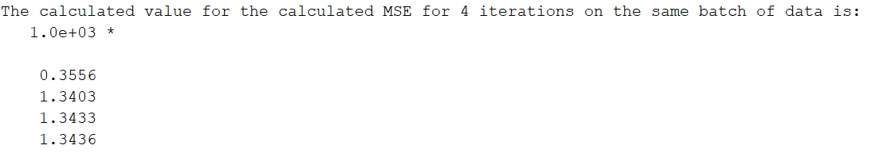

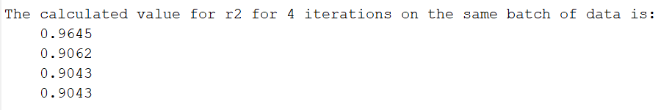
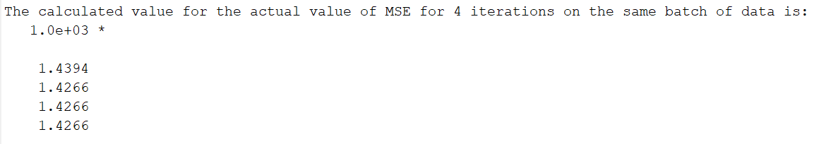
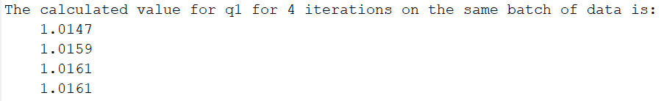

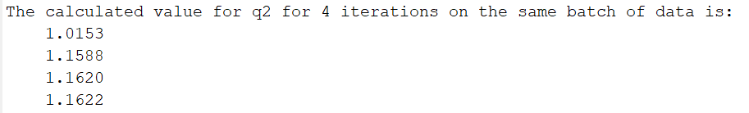
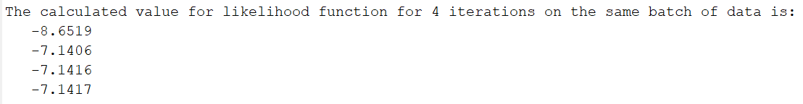

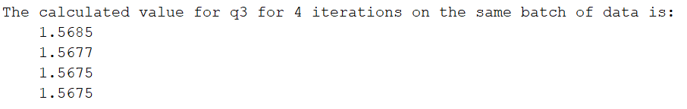
Results of Calculating Estimators of Q and R:

Slide 18
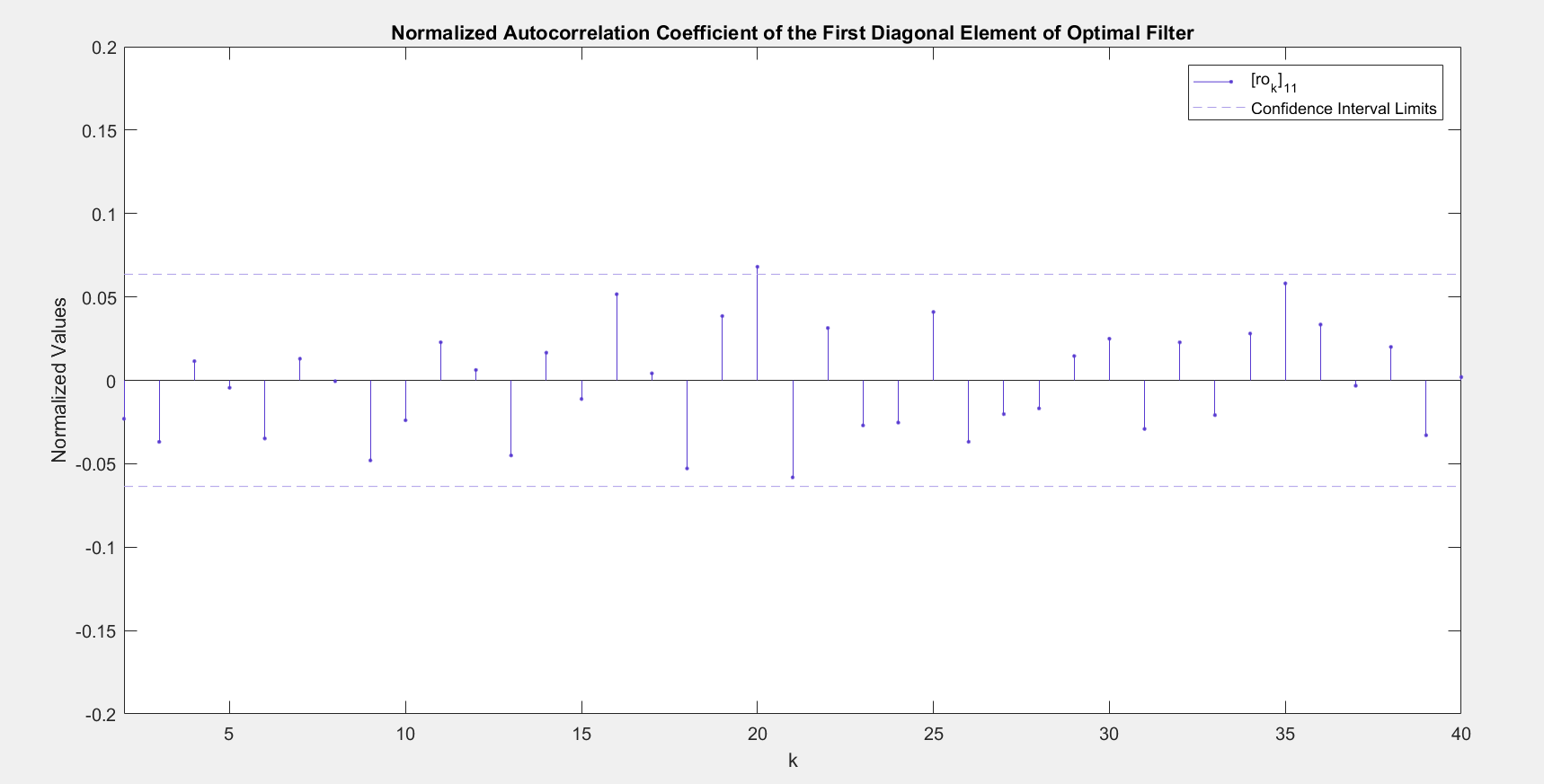
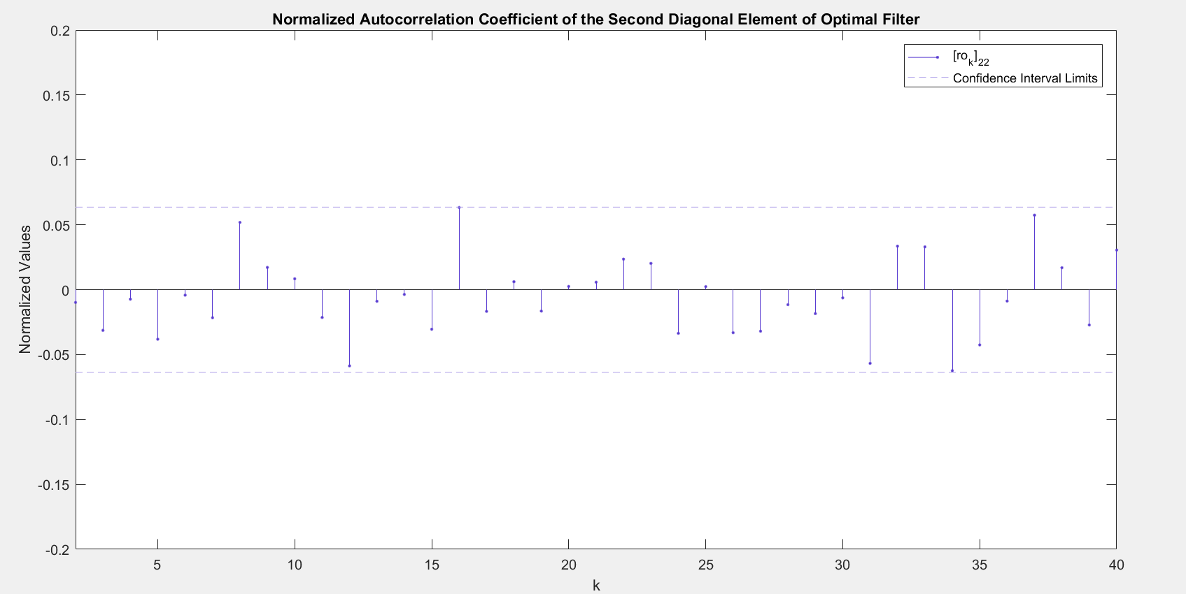
Optimality of Filter:

Slide 19
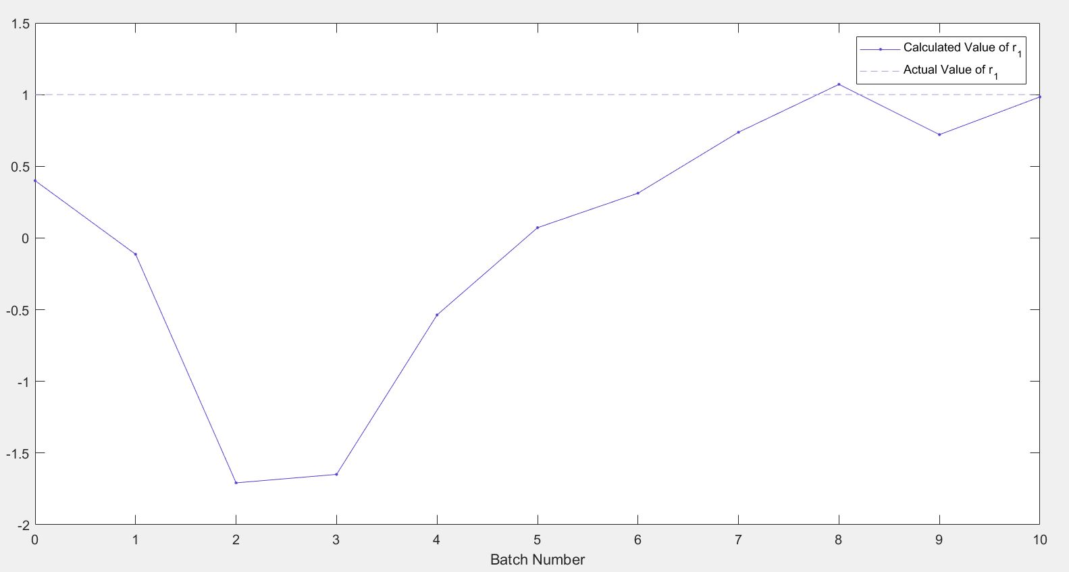
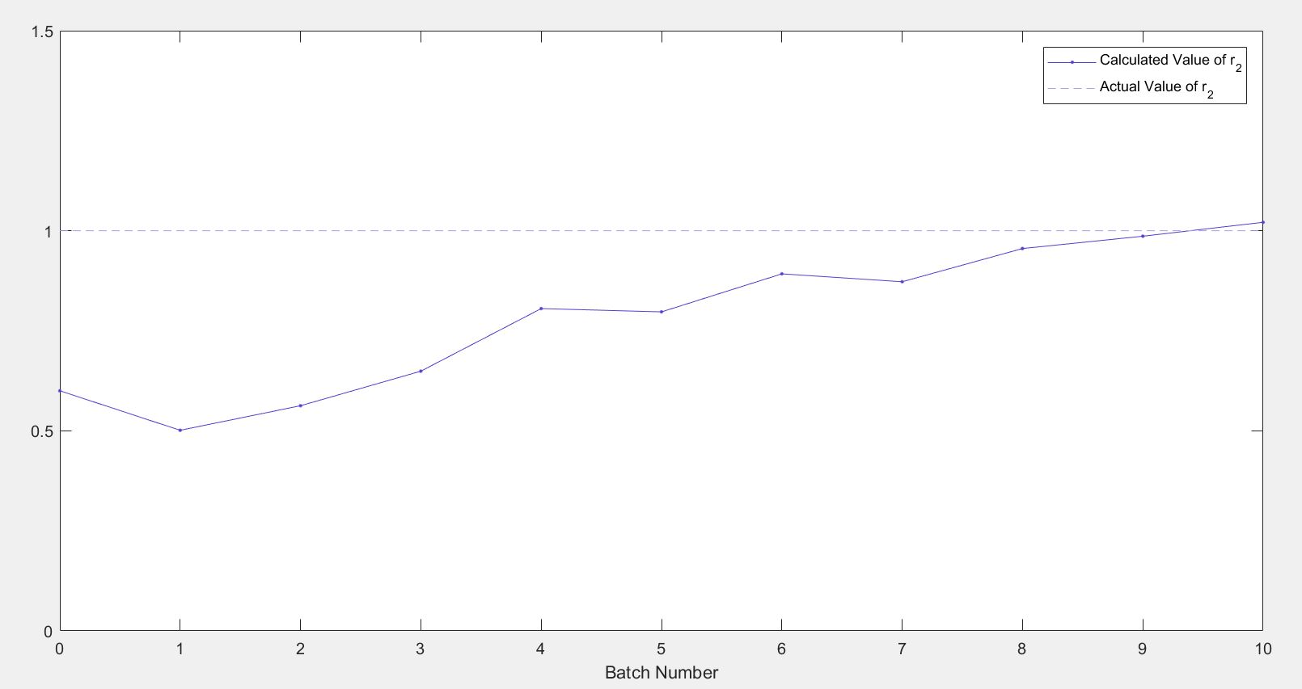
10 Batch Data Results for R:

Slide 20
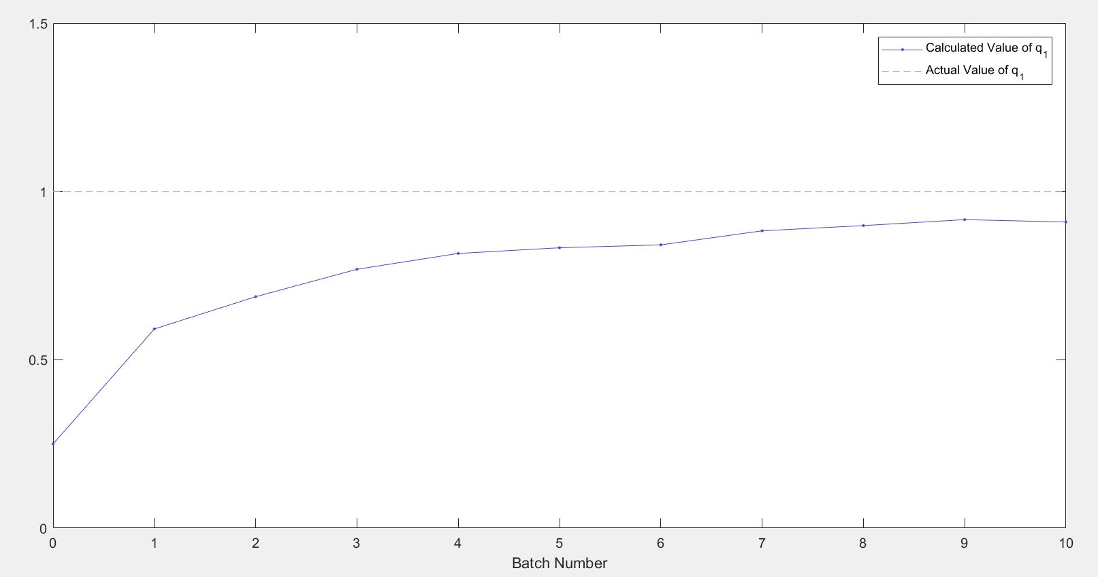
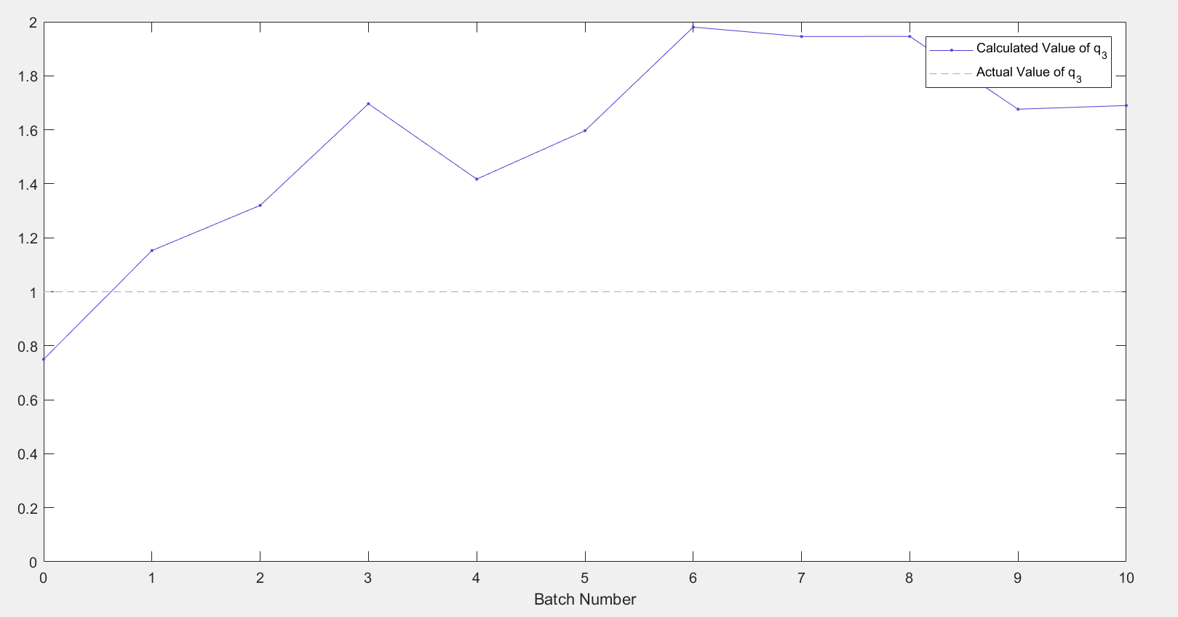
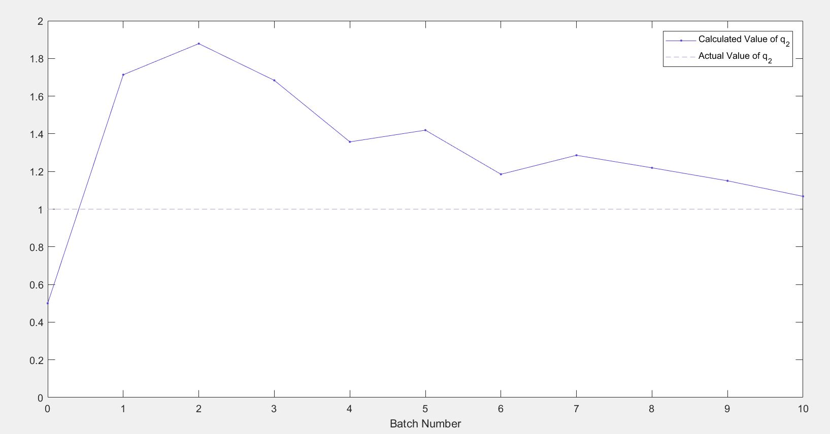
10 Batch Data Results for Q:

Slide 21
Thank You.

